Slide 1


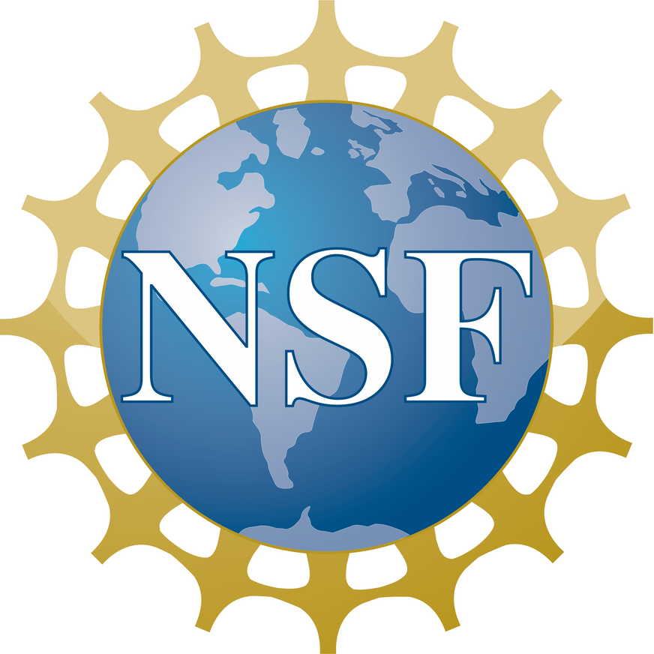

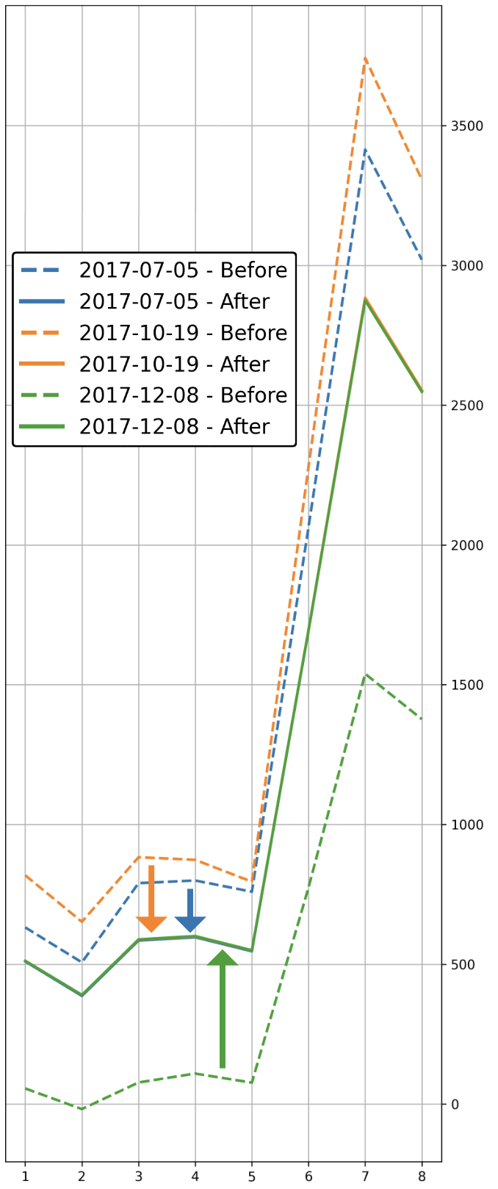

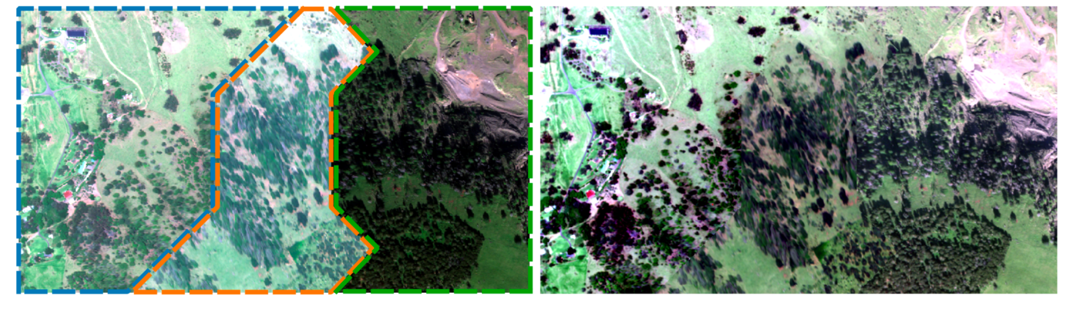

SCIENTIFIC ACHIEVEMENT
An open-source Python toolkit and QGIS plugin that adjusts image colors to improve spectral consistency for multi-image analysis.
Spectralmatch:
relative radiometric normalization toolkit for raster mosaics and time series
Spectral profile: raw/matched mean pixel values of overlapping union
SIGNIFICANCE & IMPACT
A useful preprocessing step for many geoscientific analyses in conservation, land cover, climate modeling, forest dynamics, remote sensing, and disaster assessment.
Kanoa Lindiwe, Joseph Emile Honour Percival, Ryan Perroy
University of Hawaii at Hilo Spatial Data Analysis and Visualization Lab (SDAV)
TECHNICAL APPROACH
Performs global linear regression to align the spectral profiles of overlapping areas and subsequent block-wise local gamma correction to minimize seams.
Raw Worldview images (left) and resulting matched mosaic (right)
In review for publication in the Journal of Open Source Software
More Info: doi.org/10.5281/zenodo.15312878
Code: github.com/spectralmatch/spectralmatch

